Slide 1



MEDICAL TOURISM
IN KHANTY-MANSIYSK AUTONOMOUS
DISTRICT - UGRA
LEARN HOW TO GET MEDICAL CARE IN UGRA

Slide 2



CONTANTS
2
Medical treatment in Ugra. How does it work?.........3-6
Step I: Choose a health facility ...................................7-9
Step II: Contact a specialist from a chosen health facility............................................................................10-11
Step III: Transportation and accommodation...........12-15
Step IV: Apply for a visa..............................................16-20
Step V: Welcome to Ugra! ...........................................21-22
Contact information..........................................................23
Materials prepared by
Export of Medical Services Coordination Center Federal Research Institute for Health organization and informatics of the Ministry of Health of the Russian Federation,
Project coordination center, Surgut

Slide 3

3
MEDICAL TREATMENT
IN UGRA.
HOW DOES IT WORK?

Slide 4

4
MEDICAL TREATMENT IN UGRA IS
HIGH QUALITY
THE BEST DOCTORS
LOW COST
RUSSIAN CULTURE
High quality medical care
Meeting international standards
Highly trained doctors, nurses and other medical specialists with
an international experience
Medical care in Russia has an excellent
cost-to-quality ratio
Discover rich national cultural heritage and history

Slide 5
5
5
GETTING MEDICAL TREATMENT IN UGRA
IN UGRA THERE ARE OUTPATIENT MEDICAL CARE AND INPATIENT MEDICAL CARE.
HEALTHCARE FACILITY SPECIALISTS WILL PROVIDE ASSISTANCE WITH CHOOSING THE TYPE OF MEDICAL CARE YOU NEED
OUTPATIENT MEDICAL CARE
INPATIENT
MEDICAL CARE
CHOOSE A HEALTH FACILITY ACCORDING TO THE MEDICAL PROCEDURE YOU ARE SEEKING
AND COME TO RUSSIA FOR HOSPITAL ADMISSION
GET YOUR HEALTH CHECK-UP WITHIN 2-3 DAYS WHILE YOU ARE ON VACATION
Check a healthcare facility website for more information
Check a healthcare facility website for more information

Slide 6






6
HOW TO GET MEDICAL CARE
IN KHANTY-MANSIYSK AUTONOMOUS
DISTRICT – UGRA?
STEP I
Choose
a health facility
STEP II
Get confirmation
from chosen healthcare facility
STEP III
Select type
of transportation
and accommodation
STEP IV
Apply for
a visa
STEP V
Welcome to Ugra!

Slide 7
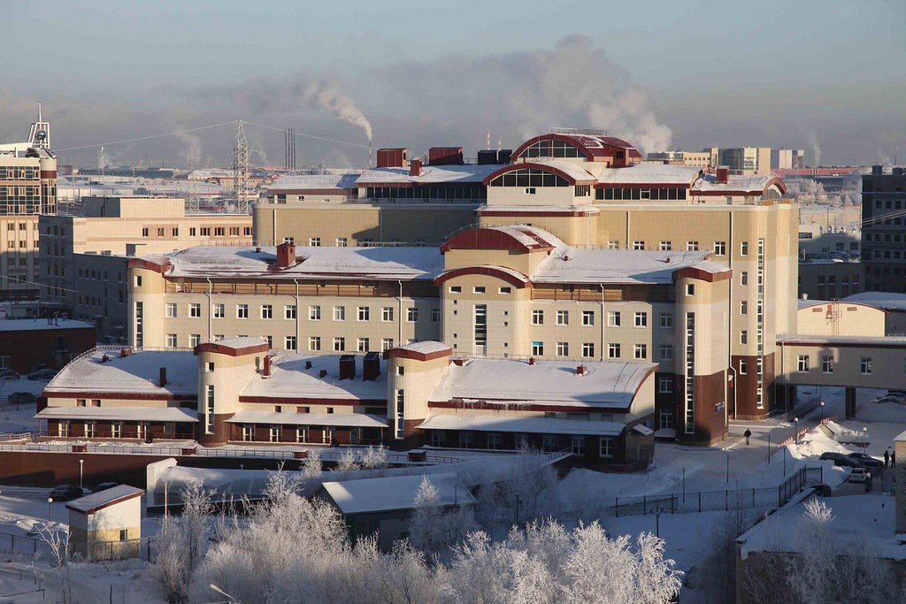
7
STEP I
CHOOSE THE BEST HEALTH FACILITY ACCORDING TO THE MEDICAL PROCEDURE YOU ARE SEEKING

Slide 8
8
8
CHOOSE YOUR MEDICAL
CENTERS IN UGRA
CARDIOLOGY
TRAUMATOLOGY AND ORTHOPEDICS
ONCOLOGY
-----------------------------------------------------------
District Cardiology Dispensary "Center of Diagnostic and Cardiovascular Surgery"
https://www.cardioc.ru/
----------------------------------------------------------- District Clinical Hospital
https://www.okbhmao.ru/
-----------------------------------------------------------
-----------------------------------------------------------
District Clinical Hospital
https://www.okbhmao.ru/
-----------------------------------------------------------
Surgut Regional Clinical Hospital
https://surgutokb.ru/
-----------------------------------------------------------
Surgut
-----------------------------------------------------------
Surgut Clinical Traumatology Hospital
www.obtc.ru/
-----------------------------------------------------------
Khanty-Mansiysk
Khanty-Mansiysk
Surgut
OBSTETRICS AND GYNECOLOGY, REPRODUCTIVE TECHNOLOGIES
Surgut
CARDIOVASCULAR SURGERY
-----------------------------------------------------------
District Cardiology Dispensary "Center of Diagnostic and Cardiovascular Surgery"
https://www.cardioc.ru/
-----------------------------------------------------------
District Clinical Hospital
https://www.okbhmao.ru/
-----------------------------------------------------------
OPHTHALMOLOGY
Surgut
---------------------------------------------------------
Surgut Clinical Perinatal Center
surgut-kpc.ru/
---------------------------------------------------------
--------------------------------------------------------
District Clinical Hospital
https://www.okbhmao.ru/
---------------------------------------------------------
Khanty-Mansiysk
Khanty-Mansiysk
Surgut

Slide 9

9
9
CHOOSE YOUR MEDICAL
CENTERS IN UGRA
THERAPY
MEDICAL
REHABILITATION
SURGERY
-----------------------------------------------------
District Clinical Hospital
https://www.okbhmao.ru/
--------------------------------------------------------------
Surgut Regional Clinical Hospital
https://surgutokb.ru/
-----------------------------------------------------
-----------------------------------------------------
District Clinical Hospital
https://www.okbhmao.ru/
--------------------------------------------------------------
Surgut Regional Clinical Hospital
https://surgutokb.ru/
-----------------------------------------------------
Khanty-Mansiysk
Khanty-Mansiysk
-----------------------------------------------------------
Surgut Clinical Traumatology Hospital
www.obtc.ru/
-----------------------------------------------------------
District Cardiology Dispensary "Center of Diagnostic and Cardiovascular Surgery"
https://www.cardioc.ru/
-----------------------------------------------------------
District Clinical Hospital
https://www.okbhmao.ru/
---------------------------------------------------------------------
Surgut
Surgut
Surgut
ENDOCRINOLOGY
Surgut
ESTETIC SURGERY
-----------------------------------------------------
District Clinical Hospital
https://www.okbhmao.ru/
-------------------------------------------------------------
Surgut Regional Clinical Hospital
https://surgutokb.ru/
-------------------------------------------------------------
Khanty-Mansiysk
Khanty-Mansiysk
--------------------------------------------------------------
Surgut Regional Clinical Hospital
https://surgutokb.ru/
-----------------------------------------------------
Surgut
Surgut

Slide 10
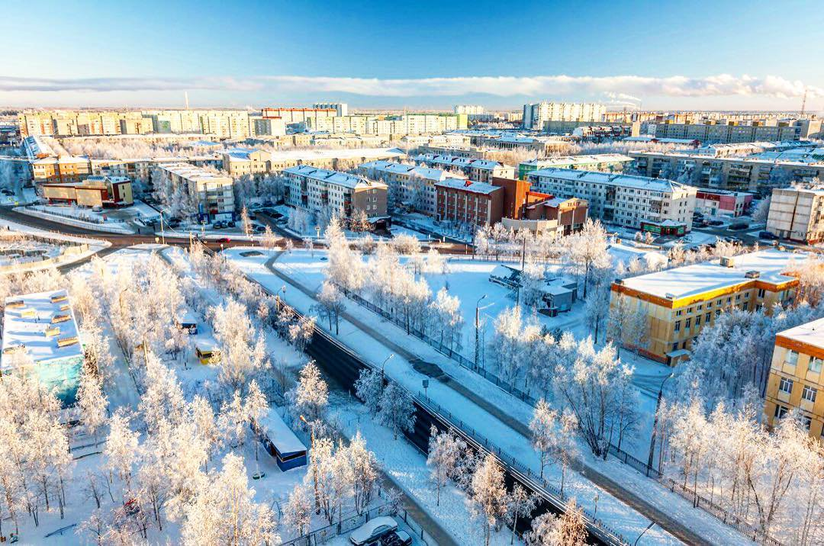
10
STEP II
CONTACT A SPECIALIST FROM YOUR CHOSEN HEALTH FACILITY TO DECIDE ON THE FORM OF MEDICAL TREATMENT YOU NEED AND FOR PREPARING DOCUMENTS FOR YOUR VISIT TO UGRA

Slide 11
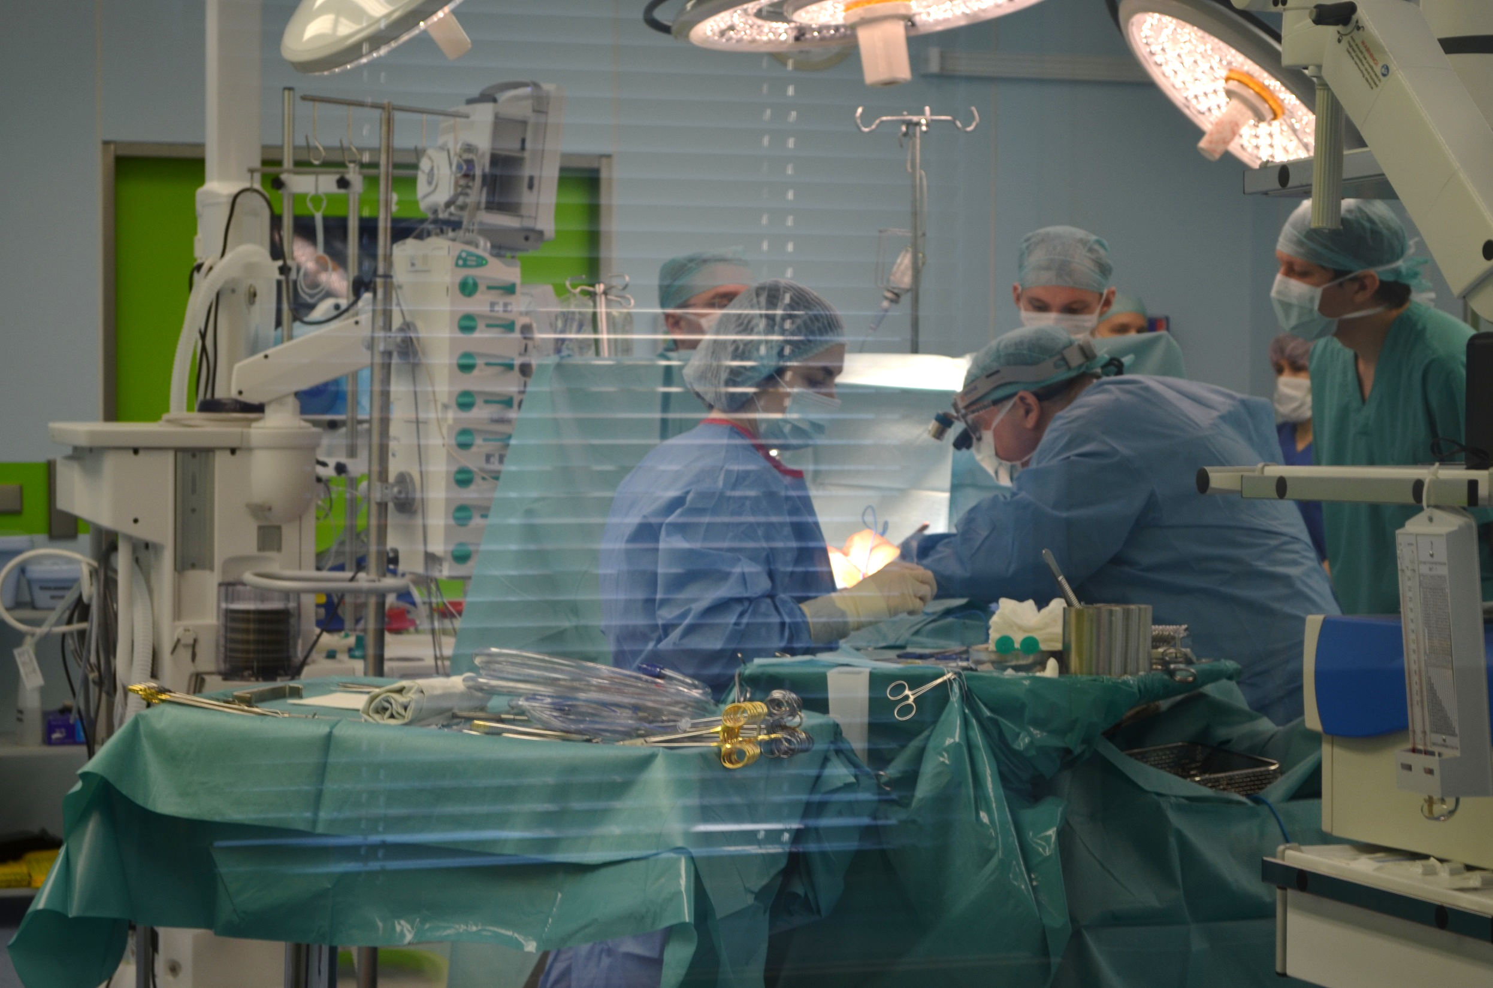

11
1. CHECK THE SECTION «MEDICAL TOURISM» ON THE HEALTH CARE FACILITY WEB-SITE
2. READ THE INFORMATION
3. MAKE A REQUEST THROUGH A PHONE CALL OR EMAIL
4. GET A CONFIRMATION FOR TREATMENT AND FOLLOW THE INSTRUCTIONS TO APPLY FOR A VISA
If you have any questions do not hesitate to contact
Export of Medical Services Coordination Center

Slide 12
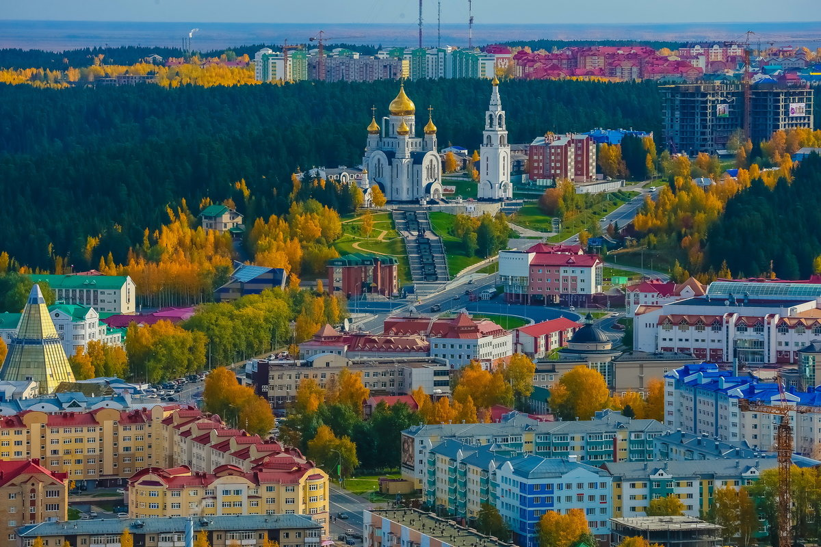
12
STEP III
SELECT THE BEST TYPE OF TRANSPORTATION AND ACCOMMODATION

Slide 13
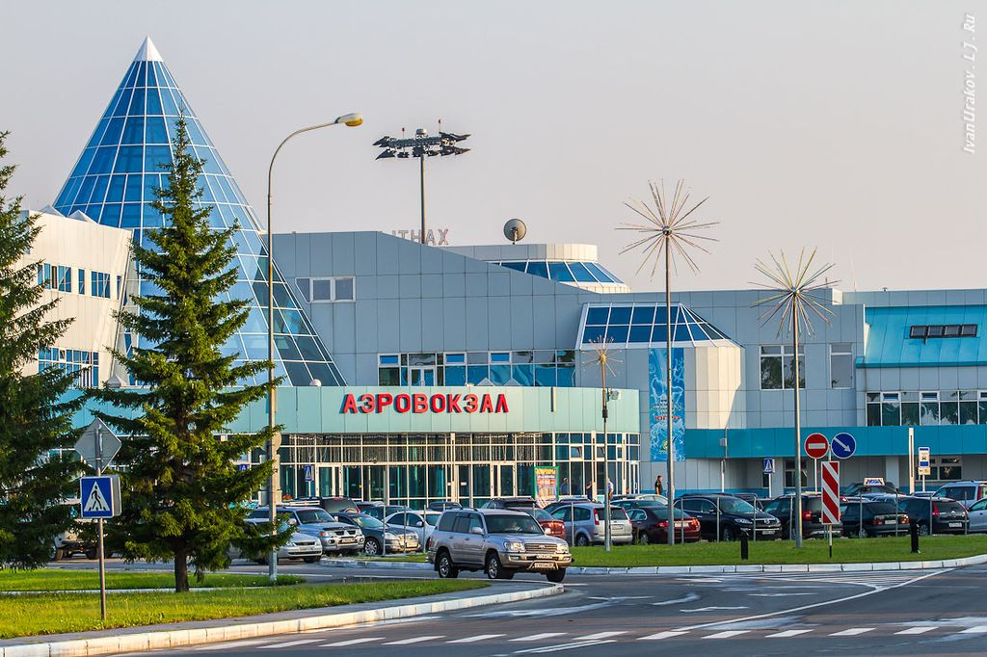


TRANSPORTATION
13
If you arrived in Surgut by plane:
PUBLIC TRANSPORTATION
DEPARTURE FROM THE AIRPORT. ROUTES AND SCHEDULE surgutbus.ru
Surgut
Surgut International Airport
TAXI
YOU CAN GET FROM THE AIRPORT TO THE CITY BY TAXI. THERE ARE PLENTY OF TAXI APPS (YANDEX.TAXI, UBER)
DON'T FORGET TO DOWNLOAD THEM BEFORE YOUR JOURNEY.
If you arrived in Khanty-Mansiysk by plane:
DEPARTURE FROM THE AIRPORT. ROUTES AND SCHEDULE https://admhmansy.ru/helpdesk/transport/
Khanty-Mansiysk
Khanty-Mansiysk
International Airport
YOU CAN GET FROM THE AIRPORT TO THE CITY BY TAXI. THERE ARE PLENTY OF TAXI APPS (YANDEX.TAXI, AUTOLIAGUE) DON'T FORGET TO DOWNLOAD THEM BEFORE YOUR JOURNEY.

Slide 14
14
14
TRAVEL APPs
to download before your trip FOR IOS and ANDROID
Public transportation and car rental (car sharing)
City maps
Attractions in Russia
1. Russian city maps:
Yandex.Maps
Google maps
2. Off-line Russian city maps:
2GIS
1. City guide Apps:
Triposo
Redigo
2. Restaurant guide App:
TripAdvisor
1. Bus, trolleybus, cable car:
Yandex.Transport

Slide 15
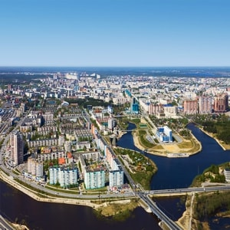
15
ACCOMMODATION
15
ACCOMMODATION OPTIONS IF YOU ARE COMING FOR OUTPATIENT ADMISSION
https://www.booking.com/
https://www.tripadvisor.com/
https://www.airbnb.com/
Please contact a tour operator or assistance companies if you need any assistance with organizing your trip.
ACCOMMODATION OPTIONS IF YOU ARE COMING FOR INPATIENT ADMISSION
Contact a specialist from a health facility for information about your accommodation. Please do not forget to do it in advance.

Slide 16

16
STEP IV
APPLY FOR A RUSSIAN VISA

Slide 17
18
17
WHAT TYPES OF RUSSIAN VISAS
ARE THERE?
TOURIST
PURPOSE OF VISIT:
TARGET TOURISM
BUSINESS
PURPOSE OF VISIT:
MEDICAL TREATMENT
PRIVATE
PURPOSE OF VISIT:
SPECIAL CASES
The period of validity: up to 30 days
For those who visit Russia for tourism purposes on a specialized tour for health check-ups or medical consultations
The period of validity: up to 90 days
For those who visit Russia for medical treatment, health check-ups, medical advice with official invitation obtained from a health facility (except target tourism for the purpose of treatment and critical care).
The period of validity: up to 90 days
For those who travel to Russia for emergency medical treatment or to visit a sick relative.

Slide 18
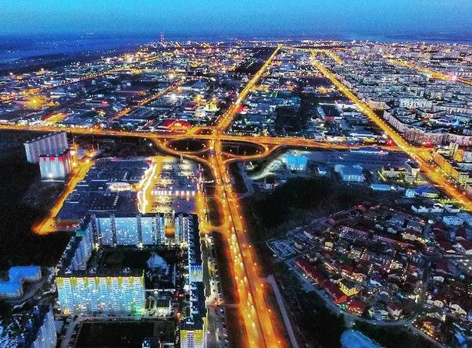
18
19
Help with processing documents for entering Russia
GETTING AN OFFICIAL INVITATION
Once you get an approval for treatment, the health facility should obtain an official invitation and submit your documents to the Federal Migration Service of Russia in order to register your migration.
APPLYING THROUGH TRAVEL AGENCIES
OR TRAVEL ASSISTANCE COMPANIES
In case you need additional help with applying for a Russian visa, you can contact travel agencies or travel assistance companies.

Slide 19
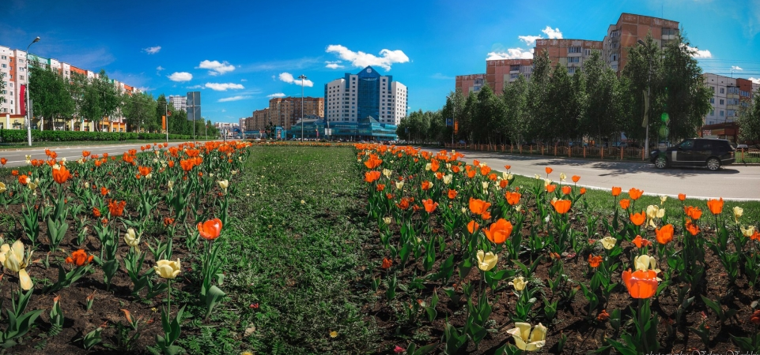

19
STEP V
WELCOME TO UGRA!
EMERGENCY TELEPHONE NUMBERS

Slide 20
USEFUL AND EMERGENCY TELEPHONE NUMBERS
20
EMERGENCY
FEDERAL MIGRATION SERVICE OF RUSSIA
POLICE
112
8 (800) 350 23 69,
* 381
8 (800) 222 74 47

Slide 21
22
21
CONTACT INFORMATION
Export of Medical Services Coordination Center Federal Research Institute for Health organization and informatics of the Ministry of Health of the Russian Federation
127256, MOSCOW, DOBROLYUBOVA ST., 11
EMAIL ADDRESS
OM@ROSMINZDRAV.RU
PHONE NUMBERS
+7 (495) 618-07-92, ДОБ. 103; +7 (495) 618-07-92, ДОБ. 104
Project coordination center, District Cardiology Dispensary "Center of Diagnostic and Cardiovascular Surgery"
EMAIL ADDRESS
POST@CARDIOC.RU
PHONE NUMBERS
+7 (3462) 52-85-40

